Slide 1
Causal Inference In Machine Learning

Slide 2

What is Causality?
Definition: Causality is about understanding how one thing causes another to happen.
Example:
Cause: Studying extra.
Effect: Getting good grades.

Slide 3

What is Inference?
Definition: Inference is using data to make conclusions or predictions.
Example: If a student has really high grades (that’s the data), we might conclude that they studied hard.

Slide 4

What is Causal Inference?
Definition: Causal inference is using data to figure out what causes what.
Example:
Data: Students who study extra get high grades.
Causal Inference: Studying extra causes better grades.

Slide 5

Correlation is NOT Causation!!
What is Correlation? When two things seem related, but one doesn’t necessarily cause the other.
Example: Kids with bigger shoe sizes read better. Does shoe size make them better readers?

Slide 6
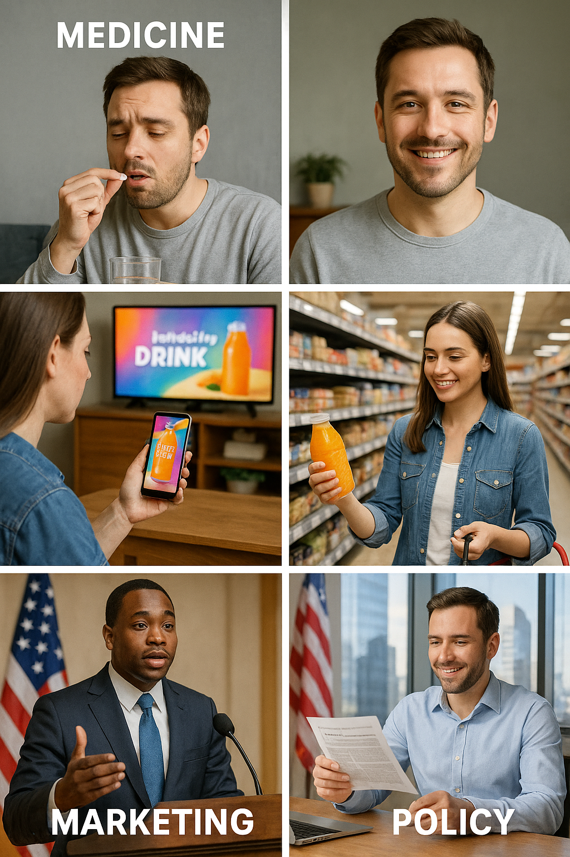
Why Does Causal Inference Matter?
Causal inference helps us understand what causes things to happen, so we can make better decisions.
Medicine: Does a medicine really help people feel better?
Marketing: Does an advertisement make people buy a product?
Policy-Making: Does a new law make the economy stronger?

Slide 7
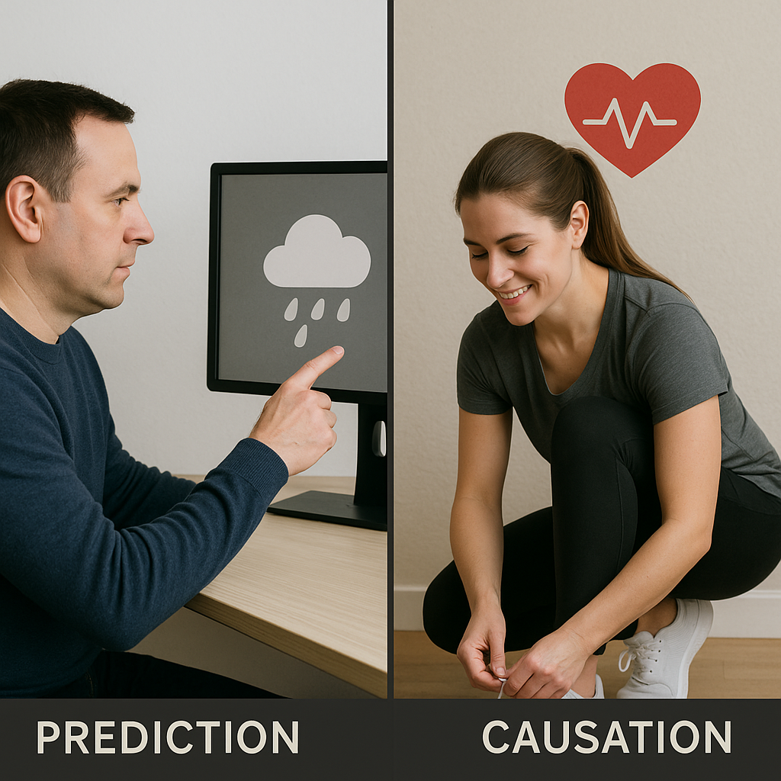
How Does Causal Inference Fit in Machine Learning?
Machine learning usually predicts what will happen, but causal inference explains why it happens.
Example: Traditional machine learning might say, ‘This person will be healthy.’ But causal inference asks, ‘Why are they healthy? Is it because they exercise regularly?’

Slide 8
How Does Causal Inference Fit in Machine Learning?
Machine learning predicts what will happen: A machine learning model can predict that it will rain this afternoon with 80% confidence, based on patterns in historical weather data..
Causal inference explains why it happens: Causal inference would dig deeper to explain that the rain is likely because a cold front (a cause) is moving in, lowering the temperature and increasing humidity, which leads to condensation and rainfall.
So, machine learning gives you the "what" (rain is coming), while causal inference provides the "why" (a cold front is causing it).
Machine learning usually predicts what will happen, but causal inference explains why it happens.
Example: Traditional machine learning might say, ‘This person will be healthy.’ But causal inference asks, ‘Why are they healthy? Is it because they exercise regularly?’

Slide 9
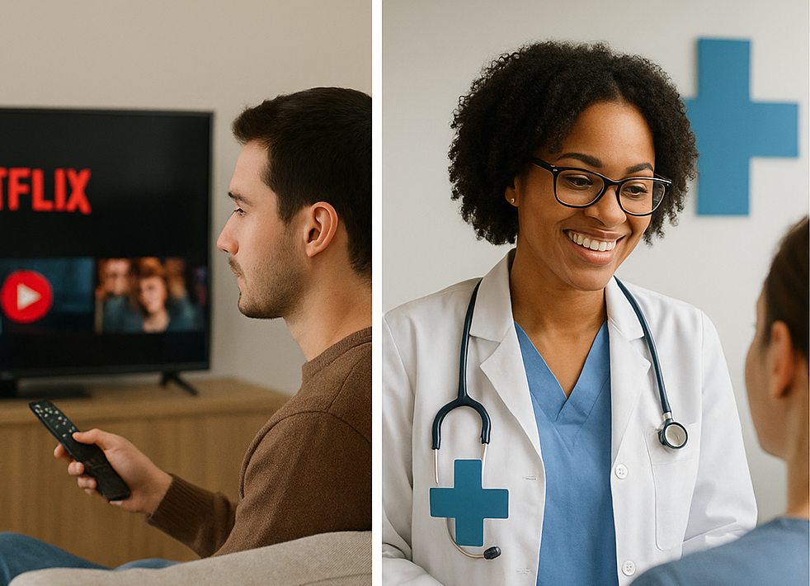
Where is Causal Inference Used in Machine Learning?
Applications: Personalized Recommendations: Suggest movies or products people will love.
A/B Testing: Find out if a new website design causes more clicks.
Healthcare Interventions: Check if a treatment causes better health.

Slide 10
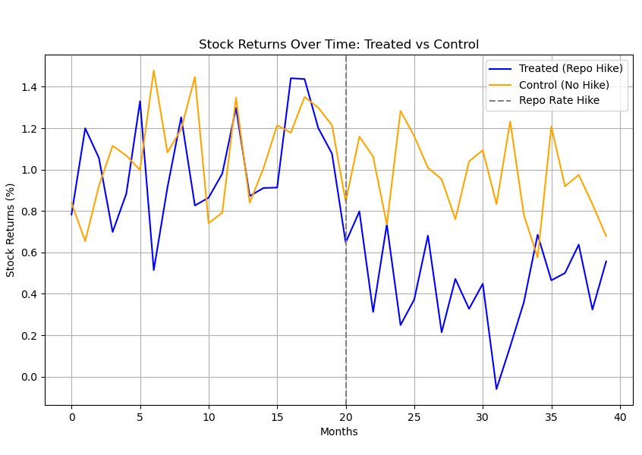
Demo: Causal Inference: Does a Repo Rate Hike Lower Stock Returns?
How to find if a repo rate hike causes lower stock returns.
We compare two groups (stocks with and without a rate hike) before and after the hike to see the real effect.
Difference-in-Differences (DiD) helps us find the true cause by removing other influences.

Slide 11
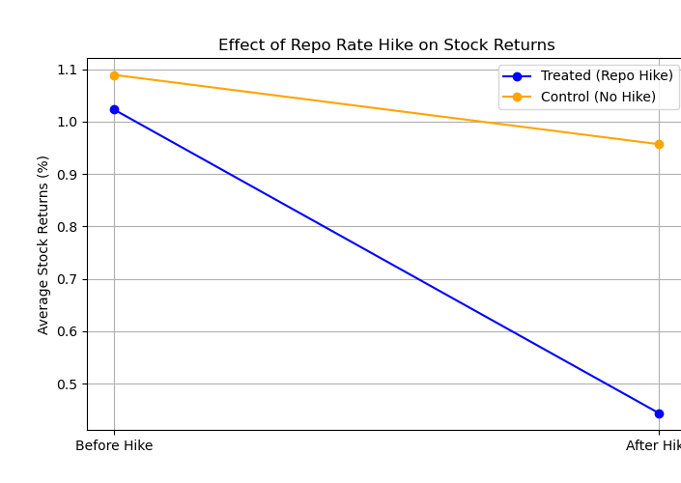
What is DiD?:
Compares changes in stock returns between:
Treatment group: Stocks affected by rate hike.
Control group: Stocks not affected.
Before vs. After: Pre- and post-rate hike periods.
Why DiD?
Isolates causal effect, removes external trends.

Slide 12
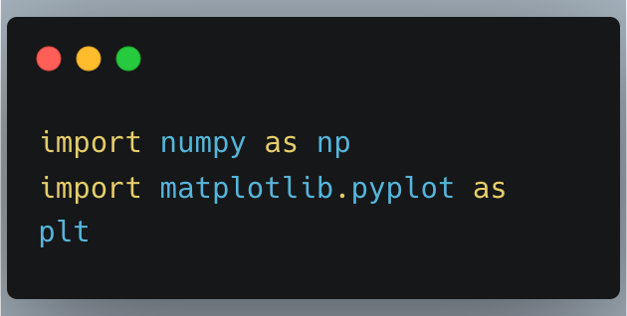
Step 0: Import Necessary Libraries

Slide 13
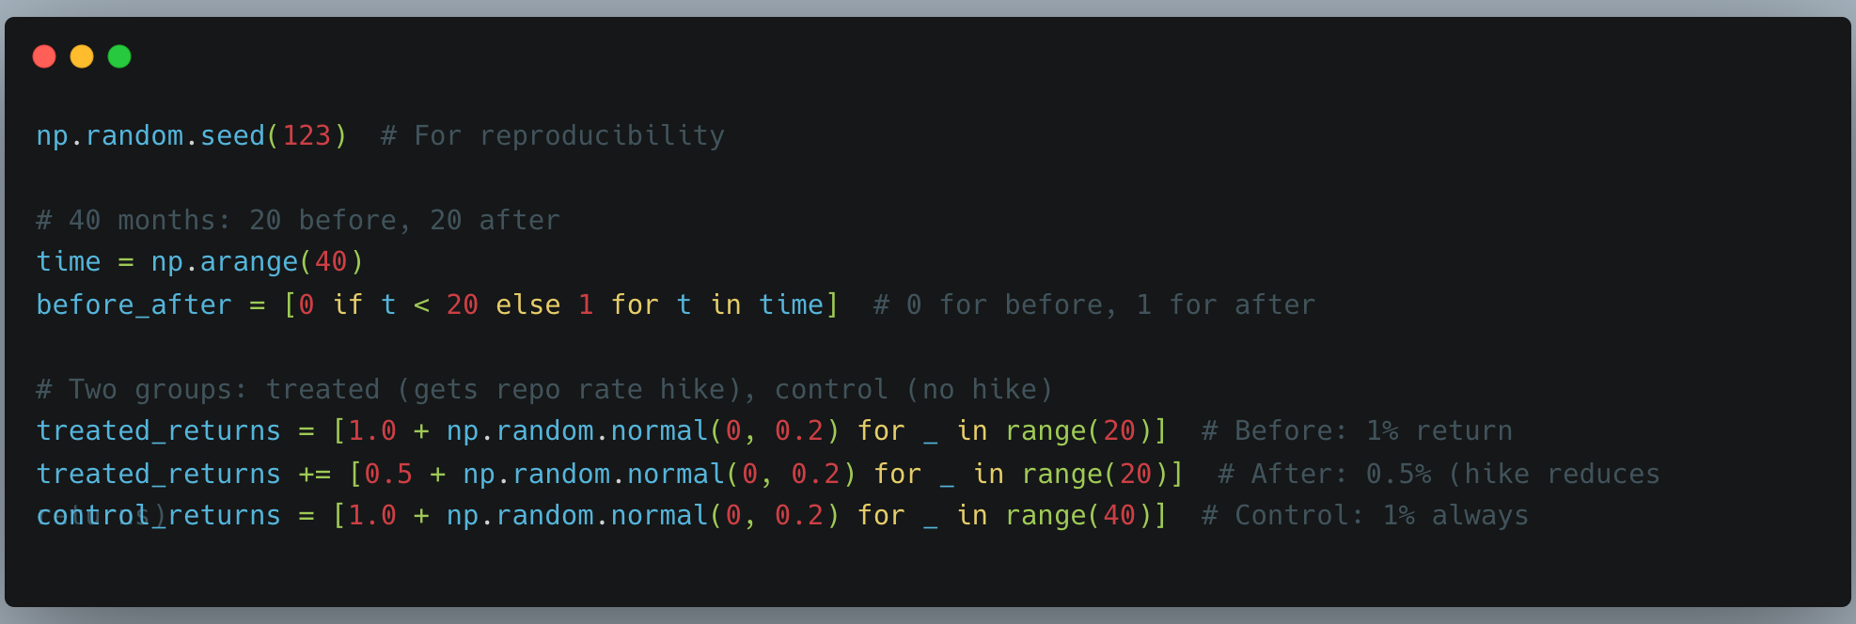
Step 1: Create simple dummy data

Slide 14
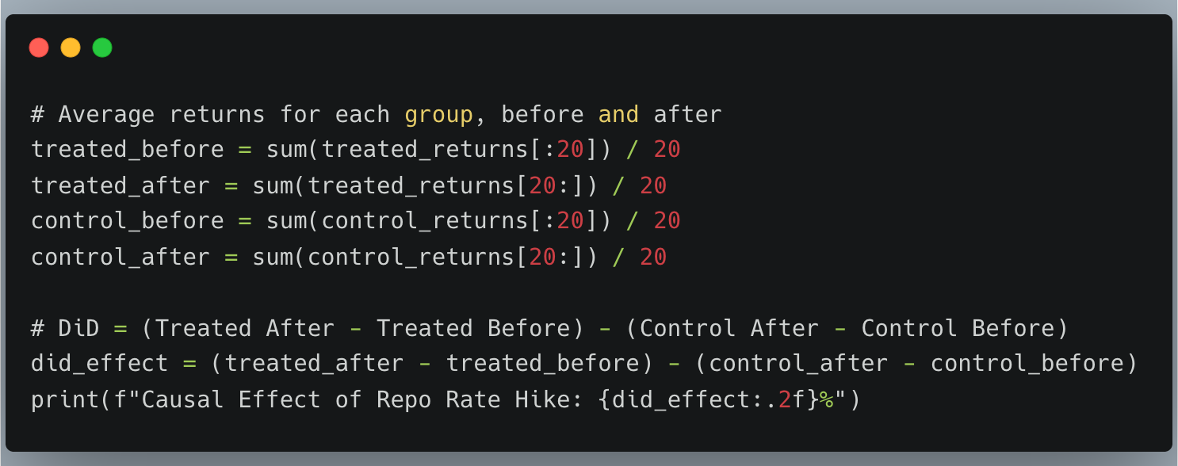
Step 2: Calculate DiD Manually

Slide 15
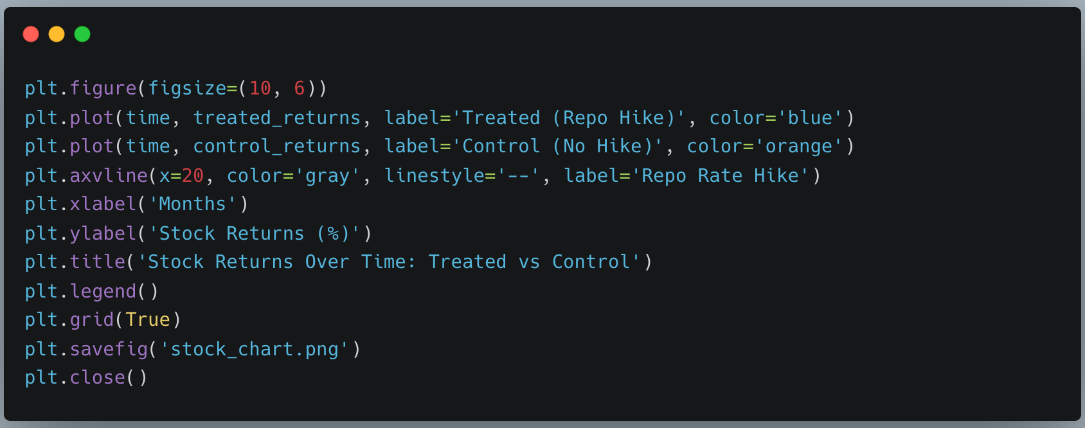
Step 3: Plot 1 - Stock chart over time

Slide 16
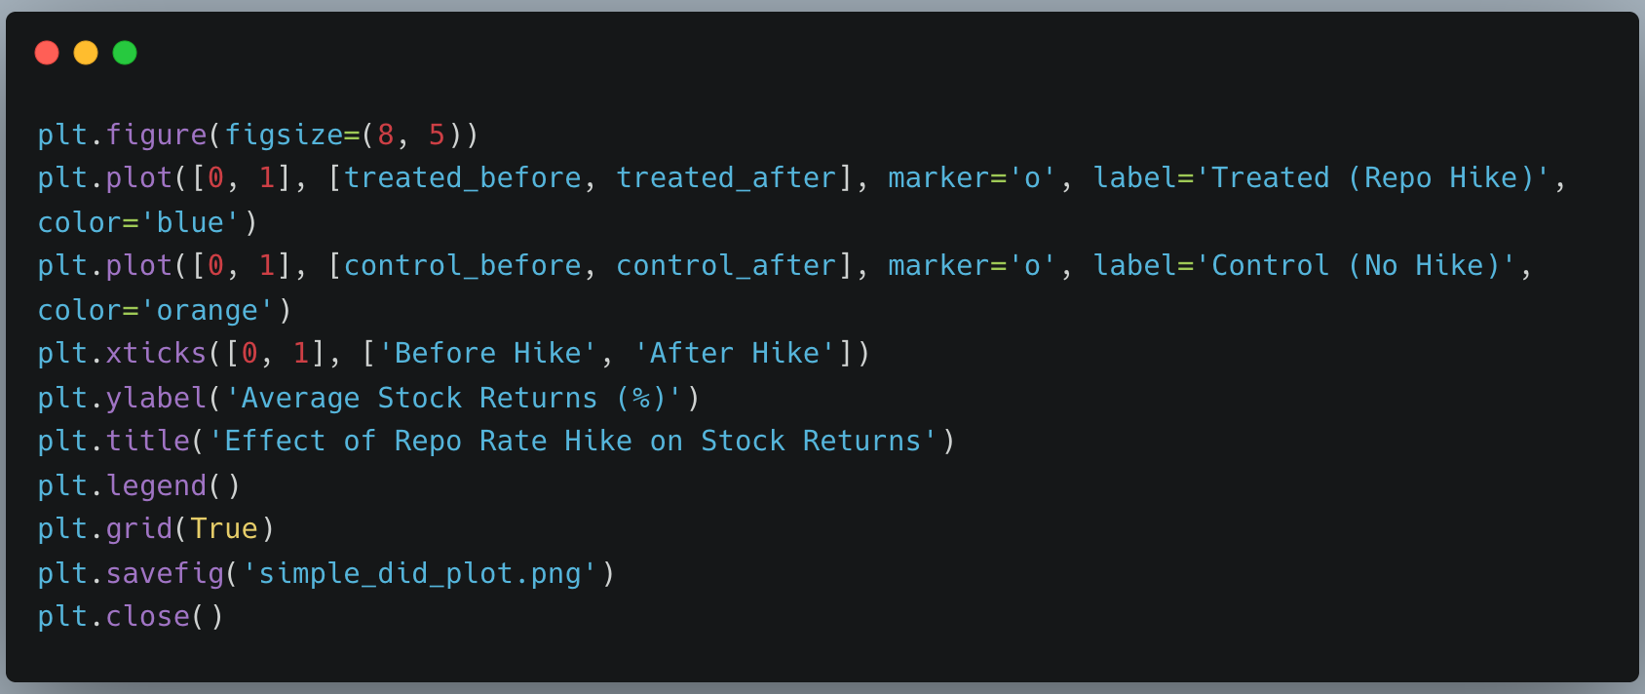
Step 4: Plot 2 - Original summary plot

Slide 17
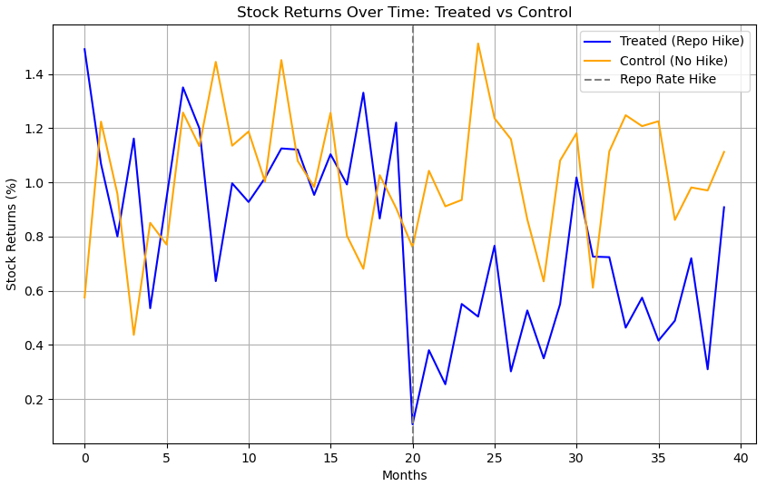
Output
Causal Effect of Repo Rate Hike: -0.53%

Slide 18
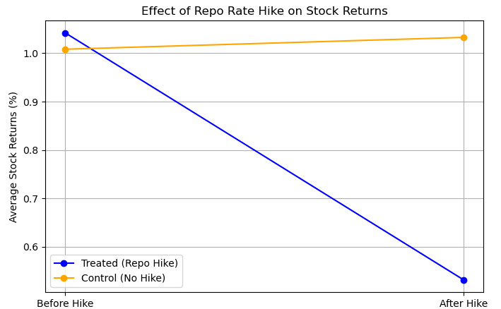
Output

Slide 19
What’s Next for My Project?
Current Demo: Shows if a repo rate hike causes lower stock returns using Difference-in-Differences (DiD).
What I Didn’t Include: Confounders (like inflation) that might affect stock returns. What’s Next: Add a confounder: Inflation (e.g., 2% on average).
Adjust stock returns for inflation (higher inflation slightly increases returns).
Control for inflation in DiD to find the true effect of the repo rate hike.
Future Plan: Upgrade this for my final Machine Learning project and share it with you all!

Slide 20
Thank You!
Visit my website to learn more about my projects: www.vaibhavkkm.com

